Slide 1
Handwritten Equation Recognizer
CAB420 – Machine Learning
Final project
William Jussiau
Johnson Loh
David Schmidt

Slide 2
Introduction
Data acquisition and pre-processing
Clustering
Classification
Demonstration

Slide 3
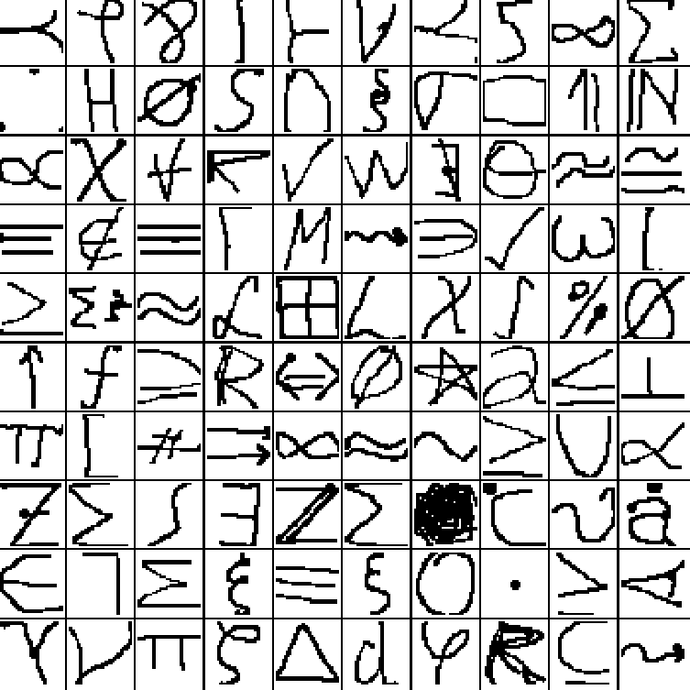
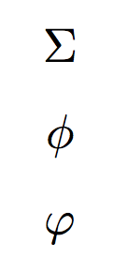
Data acquisition and pre-processing
Database: HASYv2
Thoma, M. (2017) “The HASYv2 dataset”
32x32, black and white images
369 classes
168’233 images
“Two different symbols can have the same glyph” (\sum, \Sigma)
“Two different glyphs can correspond to the same semantic entity” (\phi, \varphi)

Slide 4
Clustering (1)
Preprocessing
Convert image into grayscale, then into binary image
Convert ‘occupied’ pixels into data points
Agglomerative hierarchical clustering
Single linkage
Euclidean distance
Generate bounding box
Subdivide picture for classification
Min/Max coordinates of cluster pixels

Slide 5
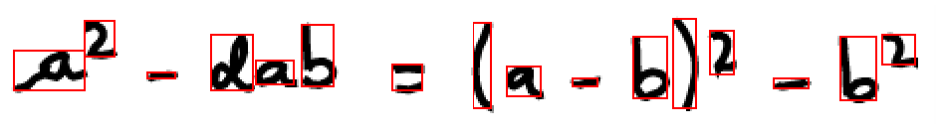
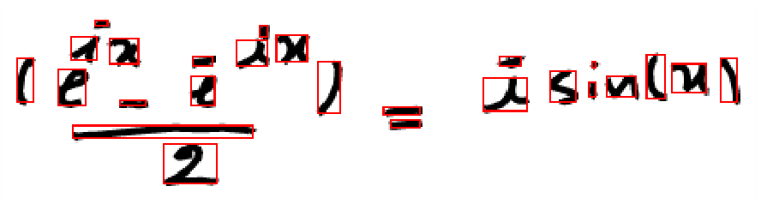
Clustering (2)
K-means and EM gaussians not suited due to initialization problem
Improvements in preprocessing data possible

Slide 6
Classification (1)

Slide 7
Classification (2)

Slide 8
Demonstration

